Slide 1

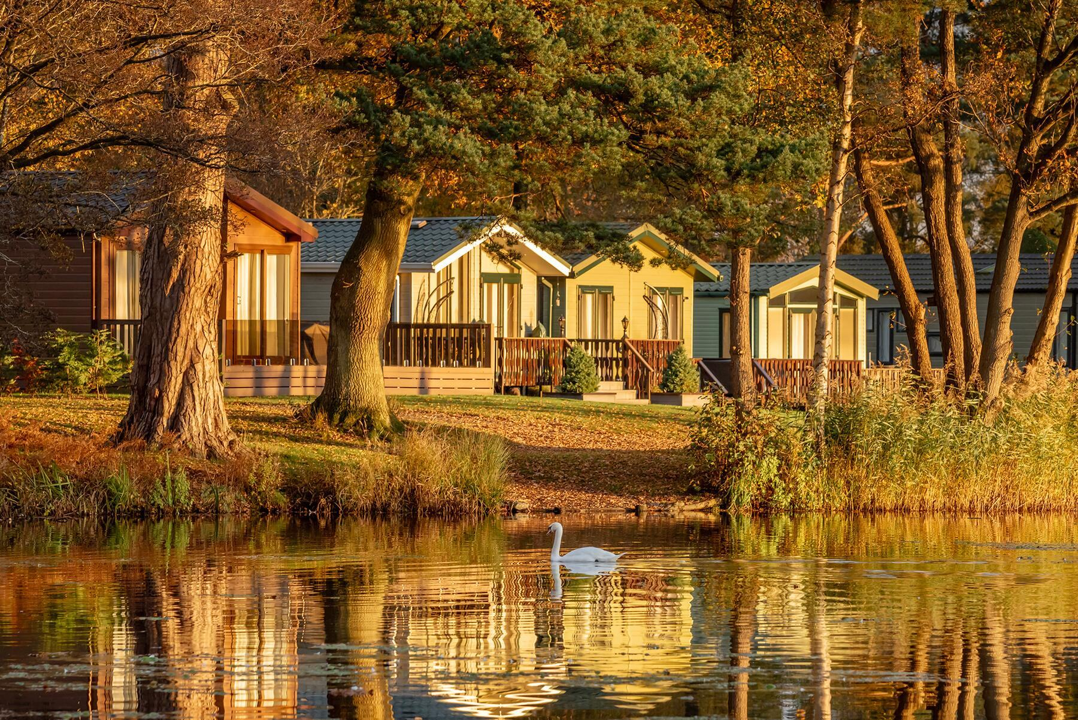
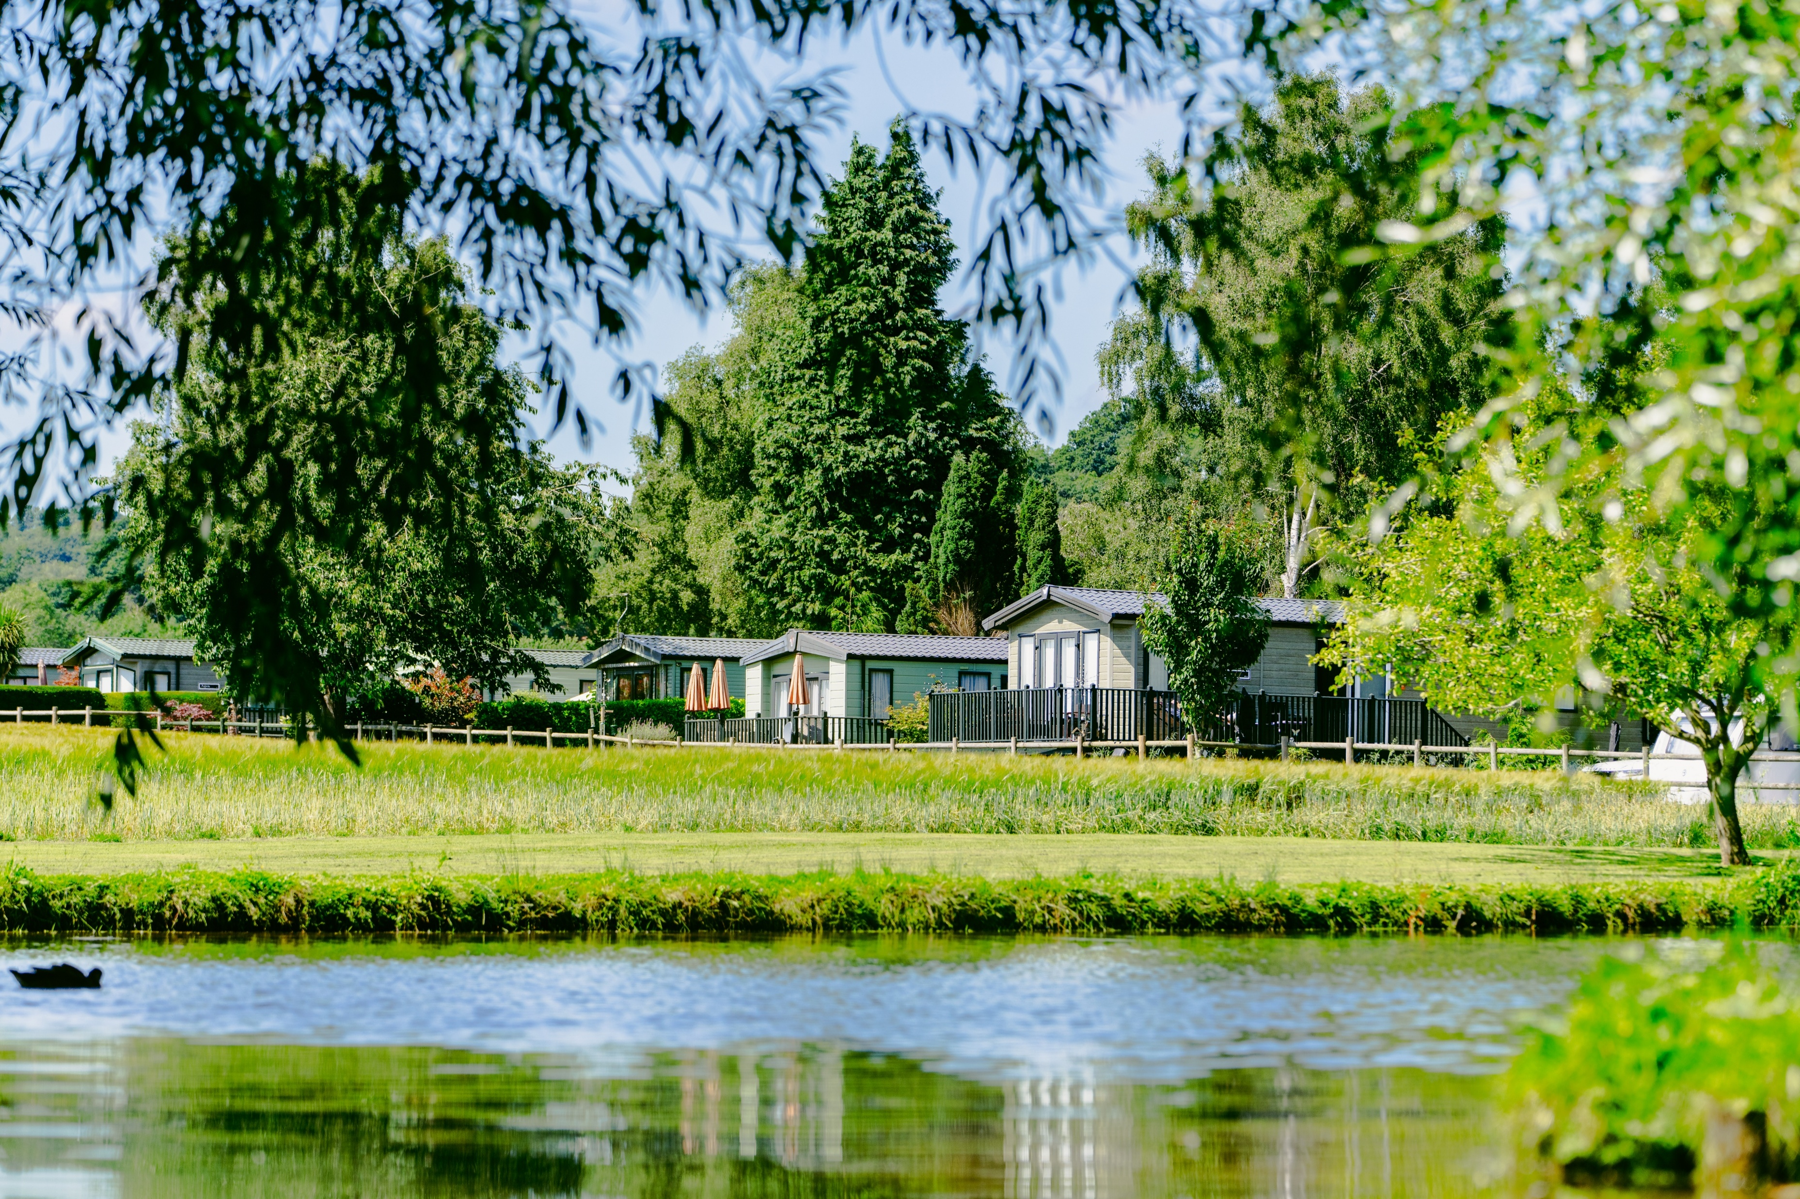
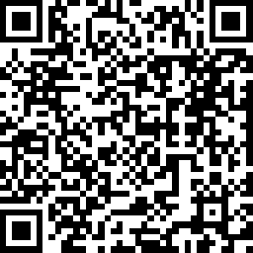

UK Caravan and Camping Alliance
Have you stayed on a
UK holiday park or campsite lately?
Tell us about your holiday by completing a short online survey and you could WIN one of these prizes*:
Scan Me!
4-night stay
at
Braithwaite
Village
Camping and
Caravanning
Club Site
3-night stay
at Experience
Freedom
glamping
accommodation
Other prizes
to be
announced….
This research will conclude with the production of a new
impact report in 2027 on the contribution holiday parks
and campsites make to the UK economy.
*T&C’s apply - www.tinyurl.com/Visitor-TCs

Slide 2
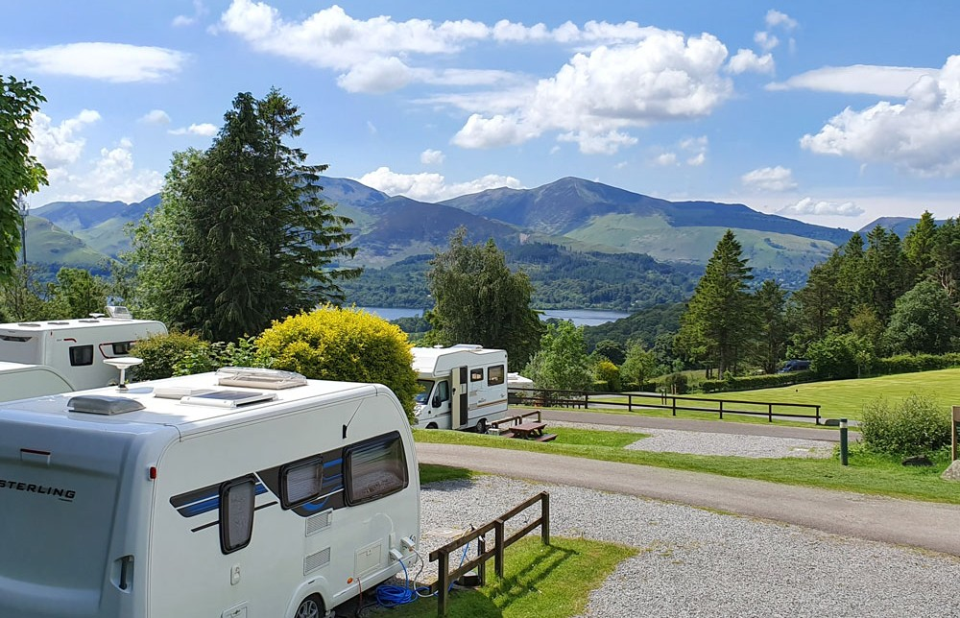
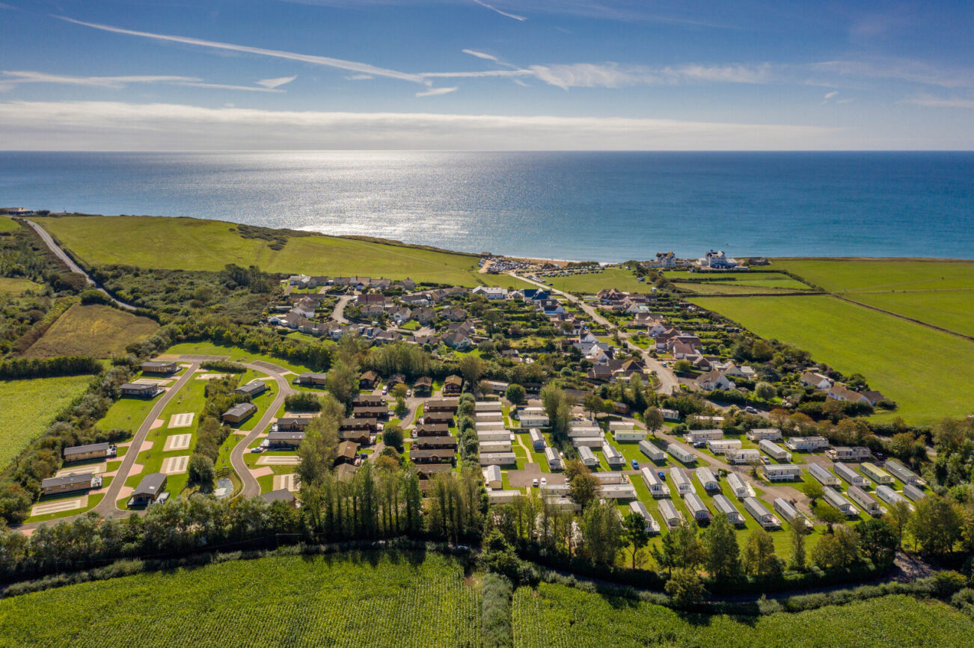
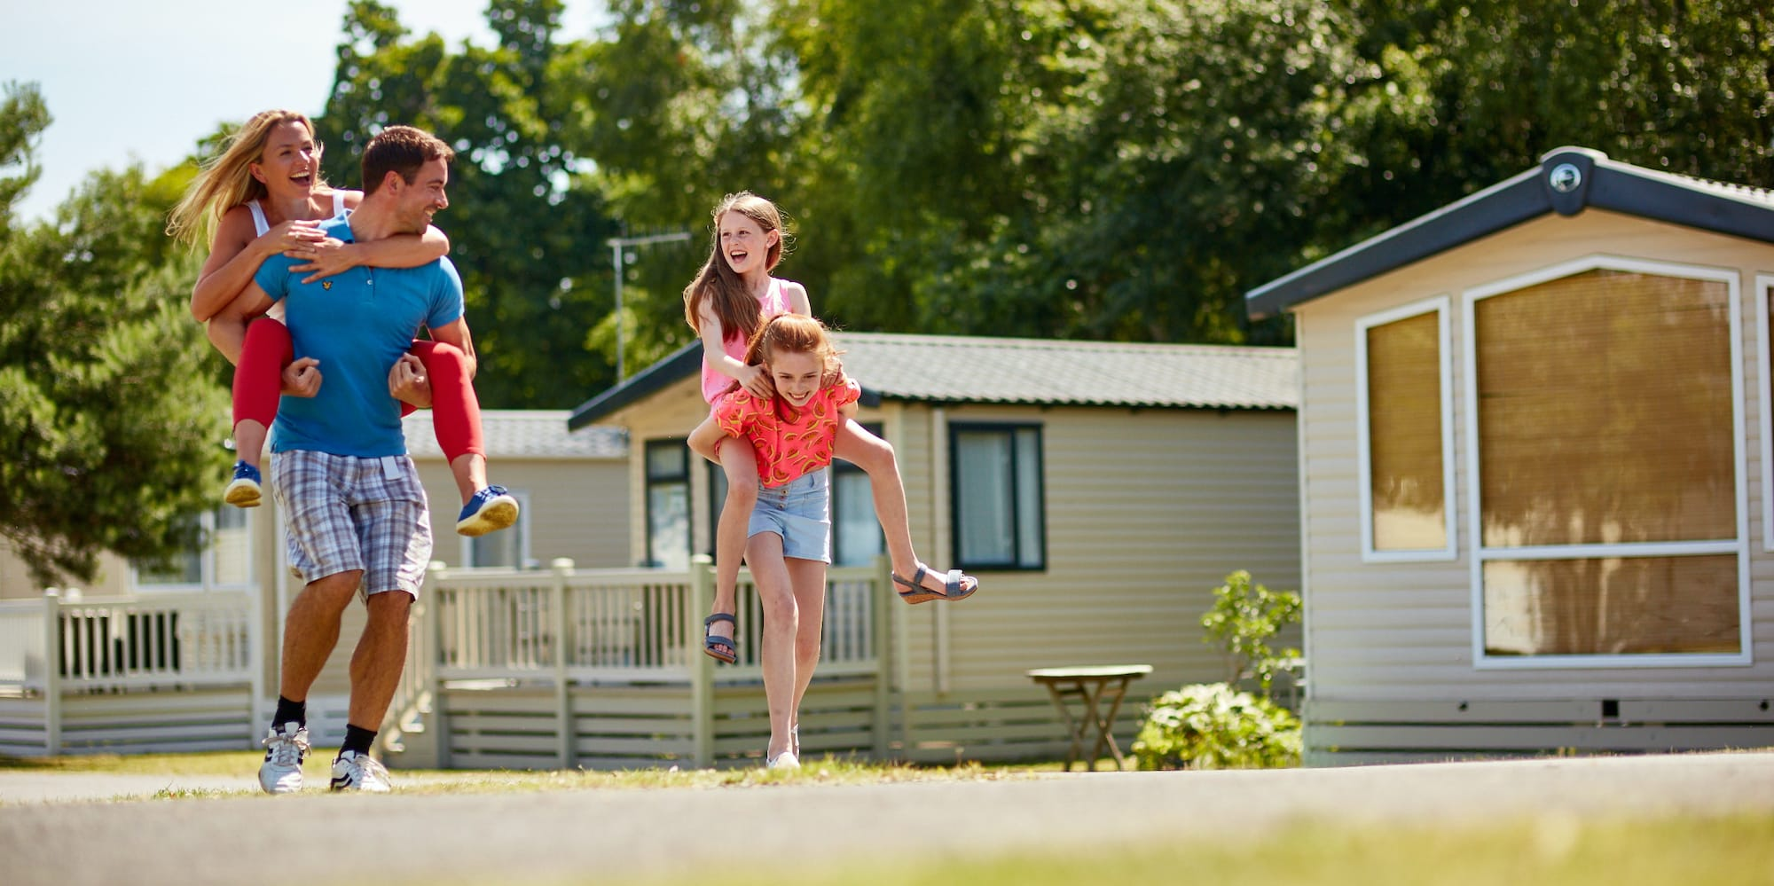

TELL US ABOUT YOUR HOLIDAY!
Staying on a UK Holiday Park or Campsite?
FILL IN A QUESTIONNAIRE AND YOU COULD WIN ONE OF THESE PRIZES*
Four-night stay at Braithwaite Village Camping and Caravanning Club Site
Three-night stay at Experience Freedom glamping accommodation
Other prizes to be announced….
Complete the survey at:
https://www.surveymonkey.com/r/VisitorPoster-26
or scan the QR code
*Terms and conditions apply - www.tinyurl.com/Visitor-TCs

